Slide 1

Introduction to Machine Learning with Numerai tournament
@parmarsuraj99

Slide 2
Machine Learning
Wikipedia:
“Machine learning (ML) is the study of computer algorithms that improve automatically through experience. It is seen as a subset of artificial intelligence.”
Arthur Samuel:
“Machine Learning refers to giving computers the ability to learn from
data without being explicitly programmed.”

Slide 3
Three Broad categories of Machine Learning
Supervised Learning
Unsupervised Learning
Reinforcement Learning

Slide 4
Supervised Learning
Learn a mapping from input (X) to output (y)
Columns in X are also called features.
Two types:
Classification for predicting discrete labels
Regression for predicting continuous values

Slide 5
Supervised Learning
Classification for predicting discrete class labels
Examples:
Is it a Cat or a Dog given an image?
Will it rain today? (Yes/No)

Slide 6
Supervised Learning
Regression for predicting continuous values
Examples:
Price of a house given it’s features
Price of a stock ($30.35)
This is what we’ll use for Numerai tournament

Slide 7
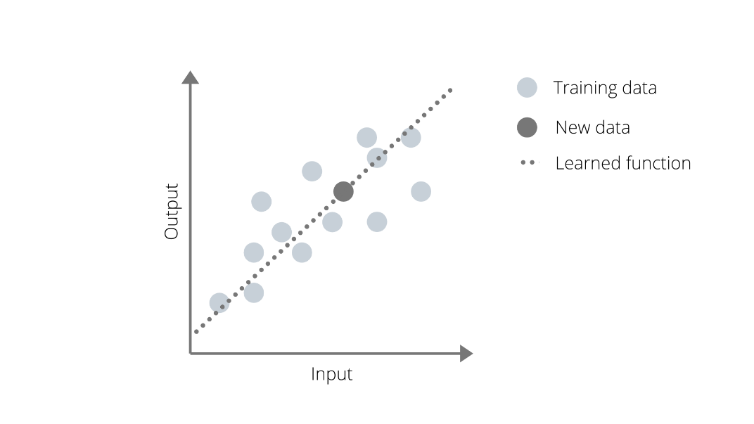
Supervised Learning: Regression

Slide 8
Three Broad categories of Machine Learning
Supervised Learning
Unsupervised Learning
Reinforcement Learning

Slide 9
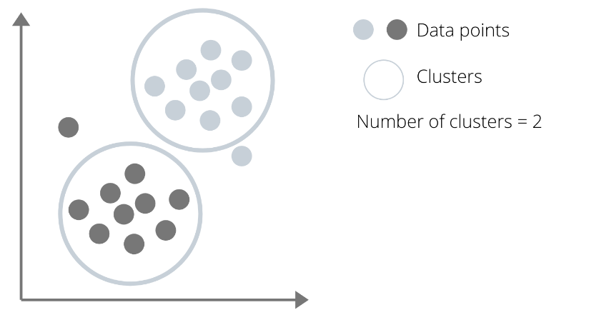
Unsupervised Learning
Clustering: Grouping data points into clusters with similar characteristics.

Slide 10
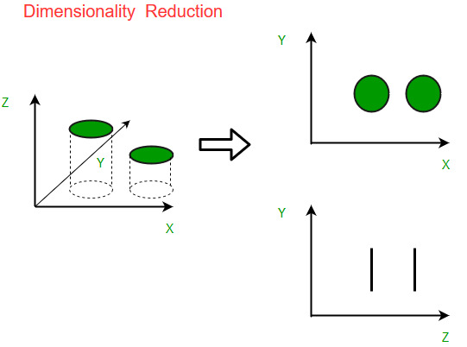
Unsupervised Learning
Dimensionality Reduction: Transform high dimensional data to a lower dimension.
Q. Can 310 features be represented by fewer features?
https://www.geeksforgeeks.org/dimensionality-reduction/

Slide 11
Three Broad categories of Machine Learning
Supervised Learning
Unsupervised Learning
Reinforcement Learning

Slide 12
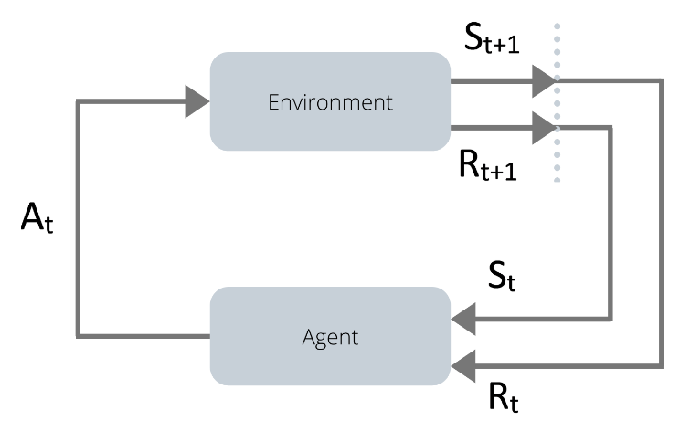
Reinforcement Learning
Agents taking action in an environment to maximize cumulative reward

Slide 13
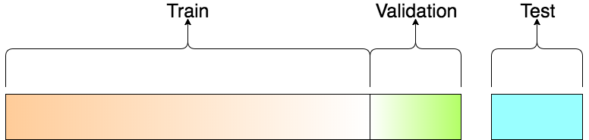
Data splits for evaluating models

Slide 14
Numerai Dataset
Training Data
Tournament Data
Validation Data
Live data

Slide 15
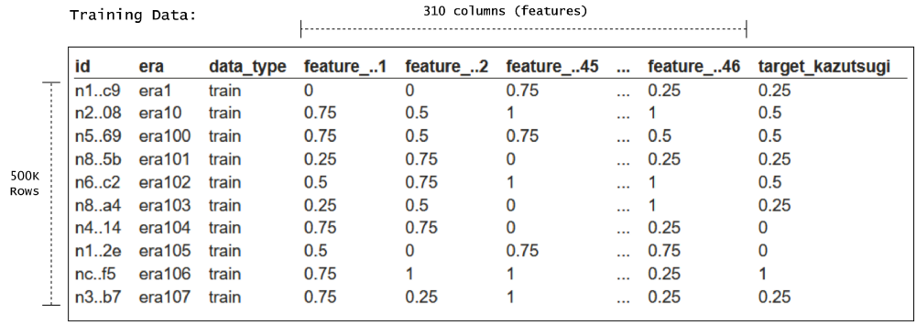
Numerai Dataset - Training Data

Slide 16
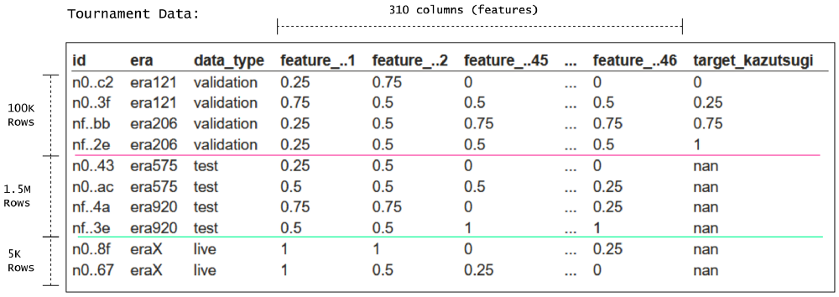
Numerai Dataset - Tournament Data

Slide 17
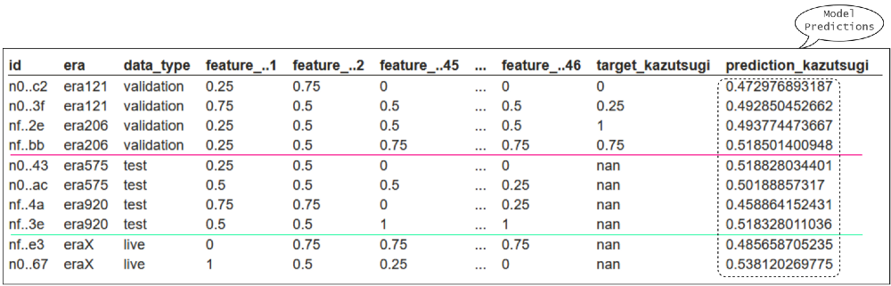
Numerai Dataset - Evaluating our predictions

Slide 18
Numerai Dataset - EDA
Already cleaned and normalised data
Well structured data
310 features grouped into eras
Non-stationary features
Supervised learning task

Slide 19
Numerai Dataset - EDA
Already cleaned and normalised data
Well structured data
310 features grouped into eras
Non-stationary features
Supervised learning task

Slide 20
How to learn in supervised setting?
Predict on a subset of dataset
Compare predictions with original target
Calculate error between true and predicted targets
Learn from that error
Repeat

Slide 21
Numerai Dataset - Scoring metrics
Our goal is to do well on live data (out of sample)
Predictions are scored based on spearman correlation
Payouts are based on predictions’ live correlation with live targets
Train on training data, Evaluate on validation data, predict on tournament data
def correlation(predictions, targets):
ranked_preds = predictions.rank(pct=True, method="first")
return np.corrcoef(ranked_preds, targets)[0, 1]

Slide 22
Numerai Dataset - Pre-processing?
Reducing dimensionality
PCA
Selecting a group of features
Based on their correlation with target
A certain groups (intelligence, strength)
Directly training on original data

Slide 23
Modelling
PCA
Sklearn Cross-Validation
CatBoost
Neural Nets in Keras

Slide 24
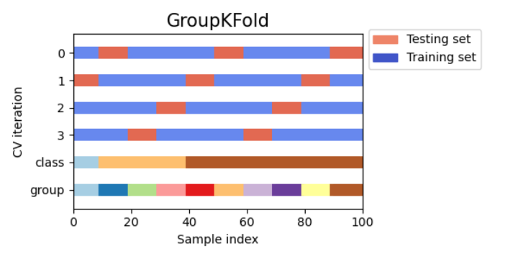
Cross-validation

Slide 25
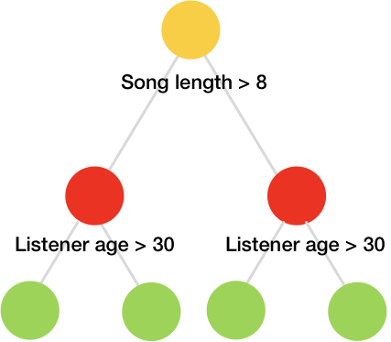
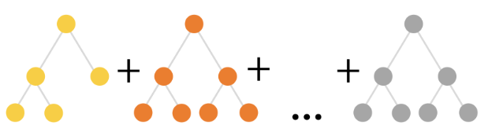
Boosted tree models
State-of-the art results for structured data
If-else questions to features

Slide 26
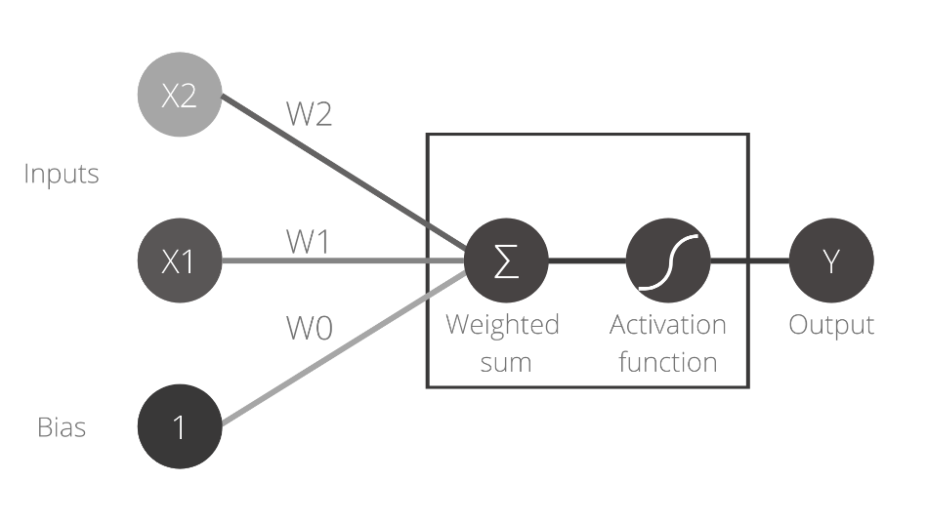
Neural Nets
Inspired from biological neurons
Input times weights, add bias, activate. Back propagate to update weights

Slide 27
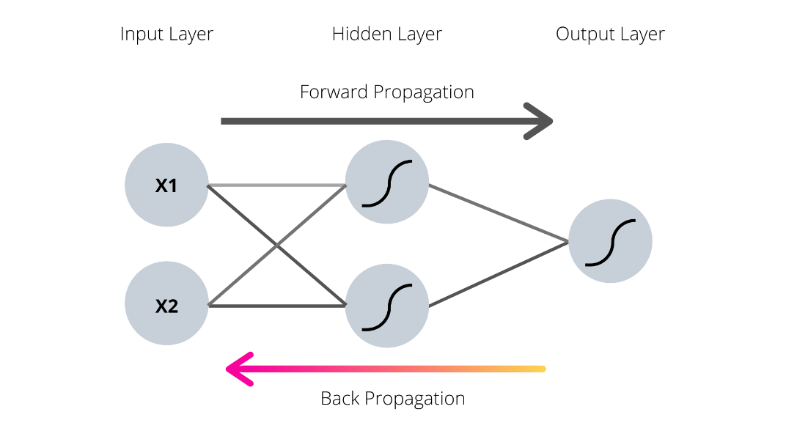
Neural Nets

Slide 28
Some more metrics ahead
Mean correlation
Sharpe ratio
Max. feature exposure
My take on metrics for numerai:
https://medium.com/@parmarsuraj99/evaluating-financial-machine-learning-models-on-numerai-3562da8fd90

Slide 29
How our predictions help Numerai?
Meta model
Staked models are combined to create Meta model
This diversifies the predictions
High meta model performance on live data

Slide 30
MMC - Meta Model Contribution
An advanced staking option which incentivizes models that are unique in addition to high performing
You can stake on MMC too
Your predictions needs to be Good + unique
https://forum.numer.ai/t/mmc2-announcement/93

Slide 31
Neutralization
A very powerful concept to boost your MMC
Be cautious using this on your models
Residualize linear correlation form your predictions
Do not use this with Linear Models
https://forum.numer.ai/t/mmc2-announcement/93

Slide 32
What’s next?
Experiment with different models
Make multi model and submit your experiments
Ask on RocketChat or Forum
Check analysis and tips notebook
Experiment with neutralization

Slide 33
Resources
Weekly Office Hours with Arbitrage
Post on metrics - More metrics for ya
My blogs - An easy guide to “The hardest data science tournament on the planet” – it has a run all colab
https://medium.com/@parmarsuraj99

Slide 34
Thank you
Especially, Karina, Ridhwanul from KCL
And Prof. Jon Taylor (@Prof_JTaylor) for their feedbacks

